Slide 1

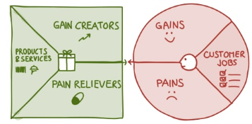
MSC3182
SOCIAL ENTREPRENEURSHIP
Lesson 3
How to position your products around the customer Value and Need
Value Proposition Canvas

Slide 2
OBJECTIVES
In this lesson, you will be able to
to position your products around the customer Value and Need

Slide 3
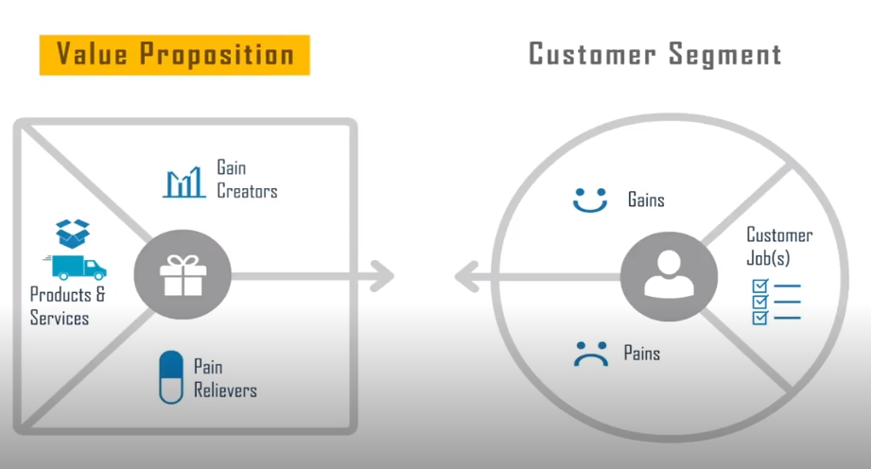
VALUE PROPOSITION CANVAS
We have discussed it in our previous class in the customer segment
Value proposition design

Slide 4
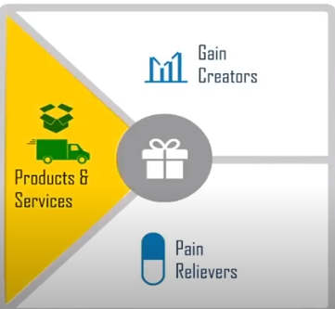
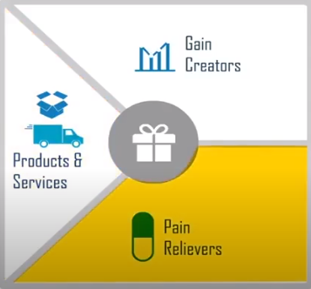
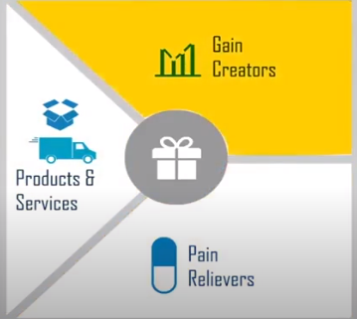
VALUE PROPOSITION
Describes the value you offer your customer
Can be broken down in to three parts

Slide 5
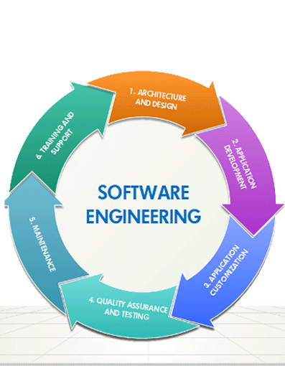
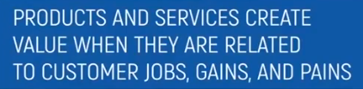
VALUE PROPOSITION – Product and Services
Refers to all the products and services you offer
Which helps your customer to complete their jobs
Not all the product and services are equally important to the customers
Some may be essential and other may be nice to have
http://mishainfotech.com/product-engineering.aspx

Slide 6

VALUE PROPOSITION – Pain Relievers
Describes, how products and services alleviates customer specific pains
They reduce or eliminate some of the things that annoys customers – before, during or after try to complete a job
Not possible for the product to deal with all the pains in a customers list
Great Pain relieves - Focus on the important pains and deals with them extremely well
https://www.webmd.com/pain-management/ss/slideshow-relieving-back-pain

Slide 7
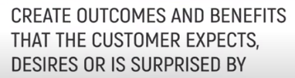
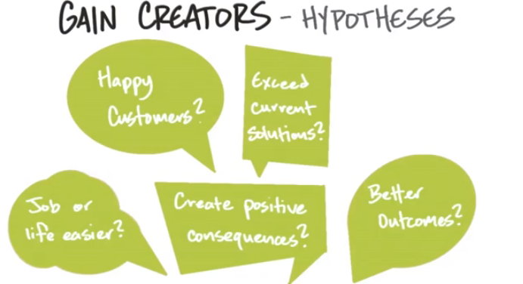
VALUE PROPOSITION – Gain Creators
Not possible for the product to deal with all the gains in a customers list
Effective gain creators – important gains that makes a real difference to the customer
https://guides.co/g/how-to-build-a-startup/3022

Slide 8
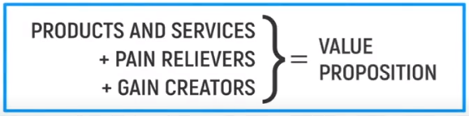

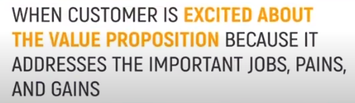
VALUE PROPOSITION
Asses the good fit with your customer segment

Slide 9
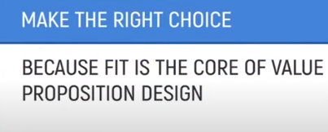
VALUE PROPOSITION
Great Value Proposition are always about making the right choice about which job, pains and gains to focus on and wish to let go off
Fit is very hard to find and maintain and the core of the VPC

Slide 10
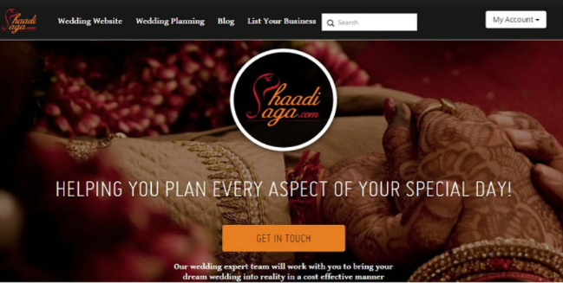
CREATING VALUE PROPOSITION CANVAS
Example
Online wedding planning platform

Slide 11
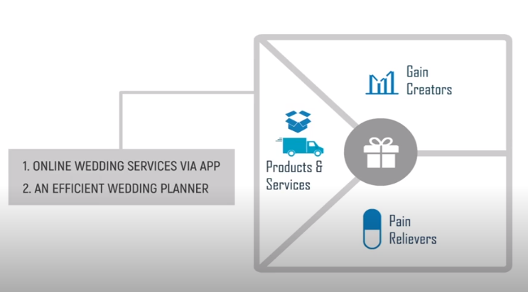
CREATING VALUE PROPOSITION CANVAS
Online wedding planning platform

Slide 12
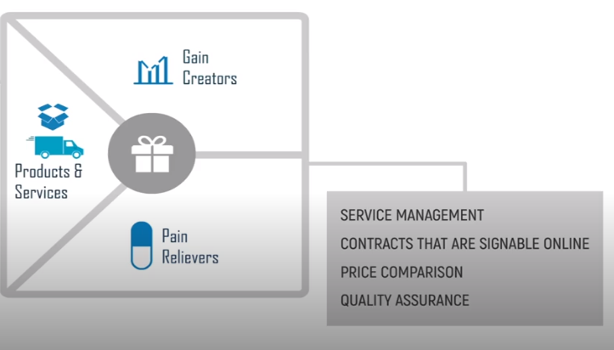
CREATING VALUE PROPOSITION CANVAS
Online wedding planning platform

Slide 13
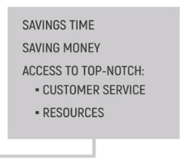
CREATING VALUE PROPOSITION CANVAS
Online wedding planning platform

Slide 14
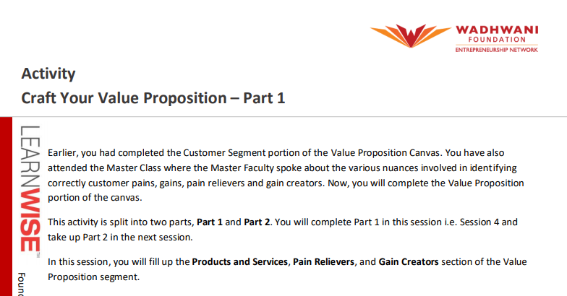
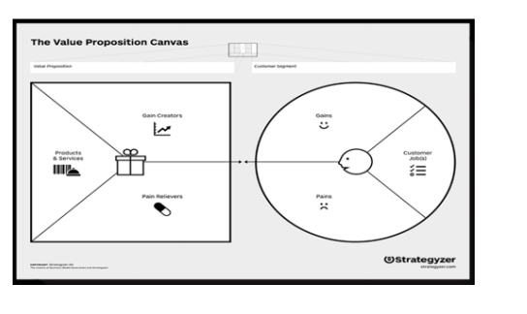
CREATING VALUE PROPOSITION CANVAS

Slide 15
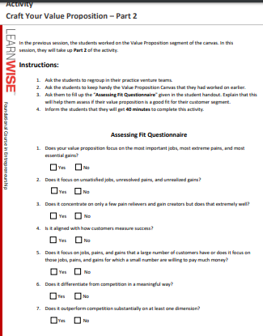
CREATING VALUE PROPOSITION CANVAS

Slide 16
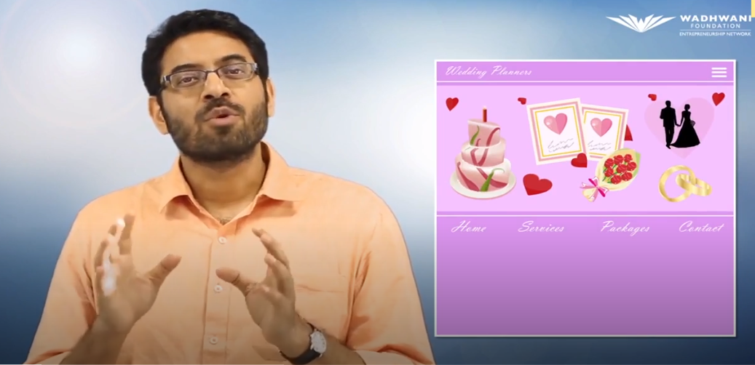
CREATING VALUE PROPOSITION CANVAS
https://lms.learnwise.wfglobal.org/IN/en/lesson/view?sid=12911946&vid=12916233&cid=12910442&cat_id=23791&user_gids=15167414
https://lms.learnwise.wfglobal.org/IN/en/lesson/view?sid=12911946&vid=12916233&cid=12910442&cat_id=23791&user_gids=15167414

Slide 17
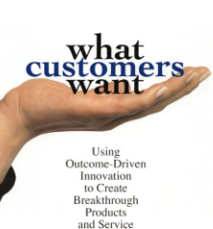
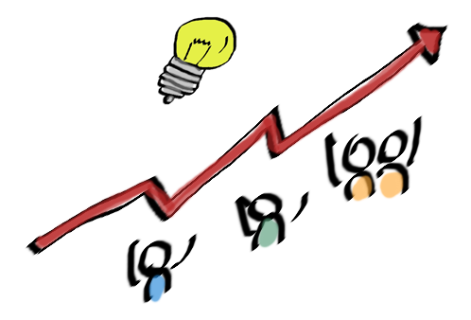
MSC3182
SOCIAL ENTREPRENEURSHIP
Lesson 3
OUTCOME DRIVEN INNOVATION
https://aktiasolutions.com/outcome-driven-innovation/

Slide 18



LAUNCH A BLOCK BUSTER PRODUCT
NO
HELP YOU LAUNCH A PRODUCT
MAY NOT BE A BLOCK BUSTER PRODUCT
An unusually successful product or service with huge sales.

Slide 19

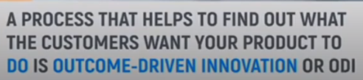
LAUNCH A BLOCK BUSTER PRODUCT

Slide 20
OUTCOME-DRIVEN INNOVATION
Outcome-Driven Innovation (ODI) is a strategy and innovation process developed by Anthony W. Ulwick.
It is built around the theory that people buy products and services to get jobs done.
As people complete these jobs, they have certain measurable outcomes that they are attempting to achieve
It links a company's value creation activities to customer-defined metrics.
ODI attempts to identify important but poorly served, and unimportant but over-served, jobs and outcomes.

Slide 21
OUTCOME-DRIVEN INNOVATION
ODI focuses on customer-desired outcome
By knowing how customers measure value, companies are able to align the actions of marketing, development, and R&D with these metrics and systematically create customer value.

Slide 22
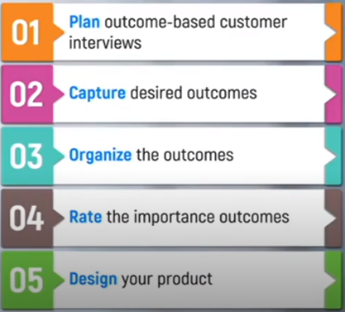
OUTCOME-DRIVEN INNOVATION – KEY STEPS

Slide 23
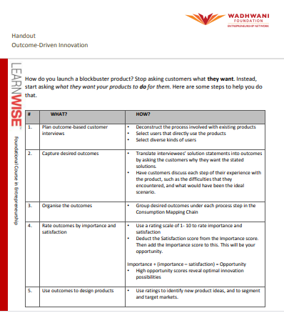
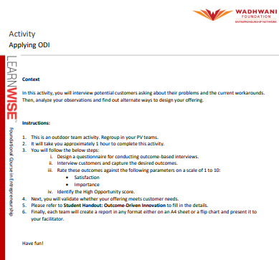
OUTCOME-DRIVEN INNOVATION – KEY STEPS

